Slide 1
Initial Analysis of
Covid-19
Shobair Abidi

Slide 2
Preliminary Setup
Notes:
Introduce the topic
hepacivirus C, West Nile virus, dengue virus, SARS and MERS coronaviruses, and SARS-CoV-2^{[2]} as well as less clinically serious pathogens such as the rhinoviruses that cause the common cold
they cause an upper respiratory tract disease,

Slide 3
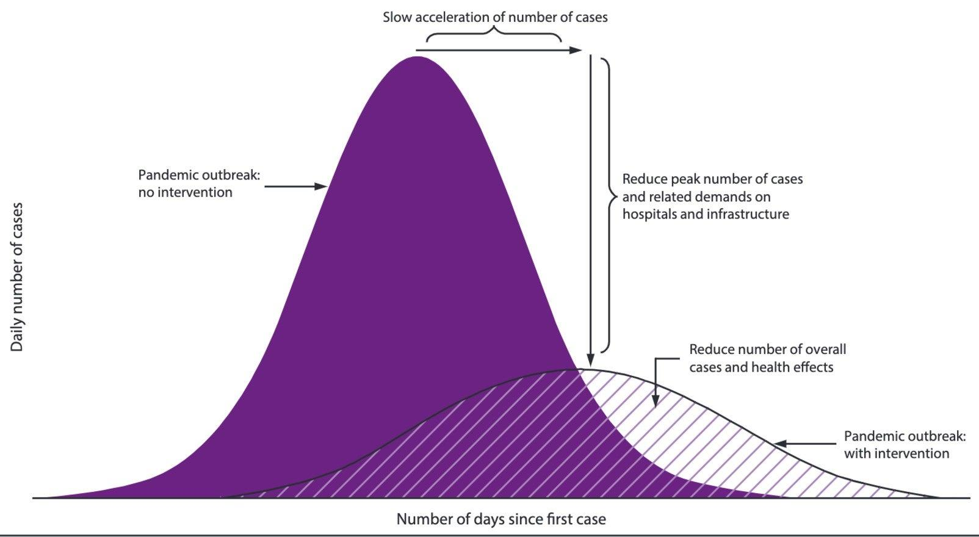

Purpose
Contagion spread
Correlation
Countermeasures
Accelerating affects
Climate
Flatten the Curve
$H_{0}: {\tilde{x}}_{CaseRateLo} −{\tilde{x}}_{CaseRateHi}=0$

Slide 4
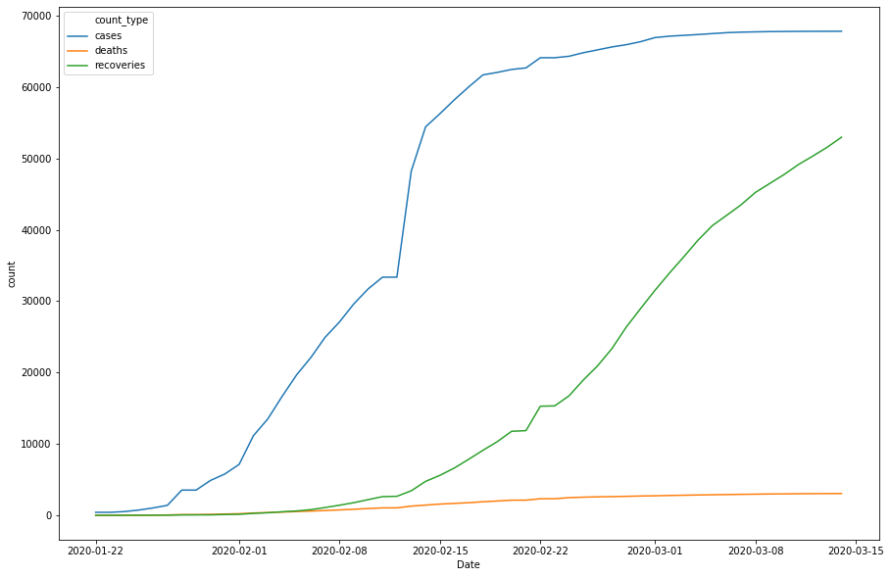
Dataset
Defining Critical Values
Rate of change in Cases, Deaths, and Recoveries
Day Zero
Choosing Dataset
Picking Correlation to test
Link

Slide 5
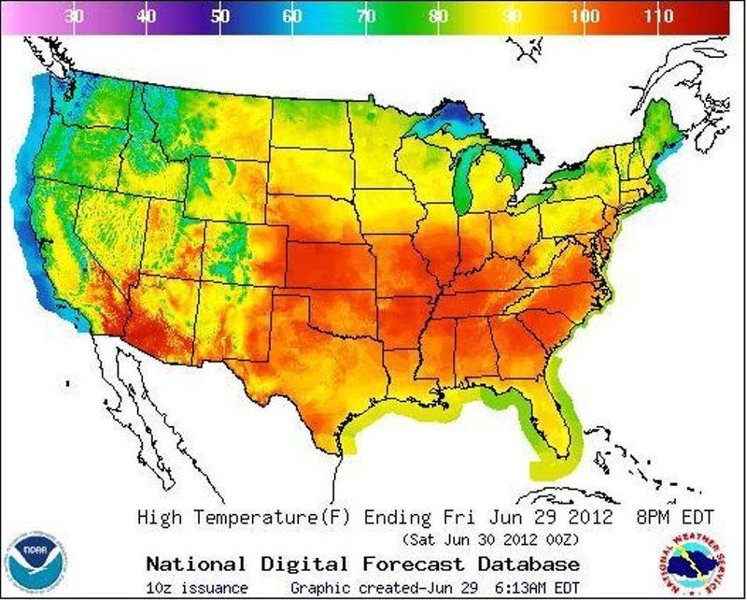
Weather
Max Temperature / Week
Min Temperature / Week
Mean Temperature / Week
Temperature Differential / Week
Climate

Slide 6
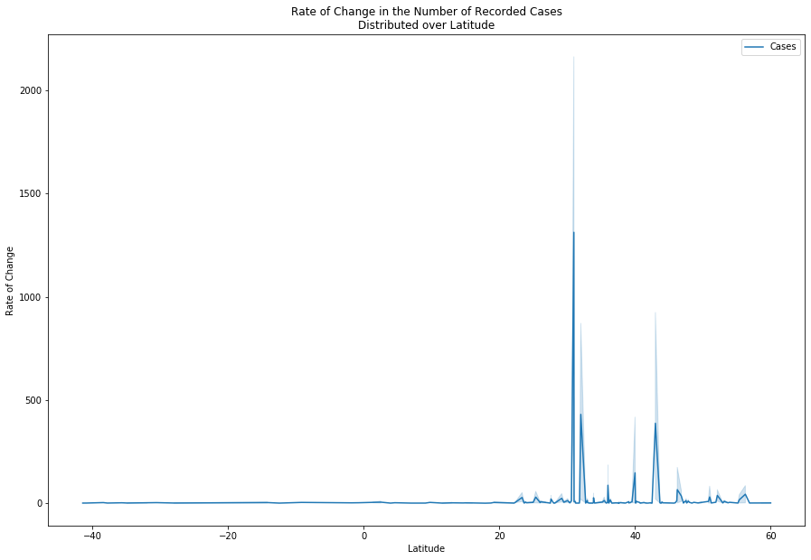
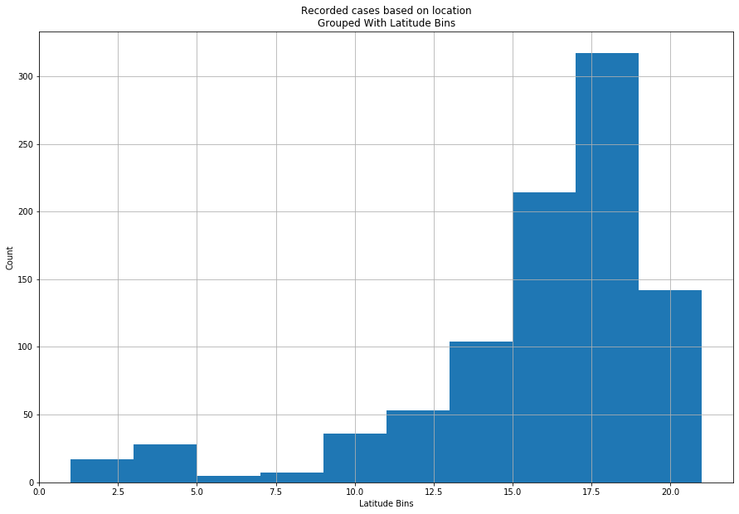
Latitude

Slide 7
What can we derive without correlation?

Slide 8
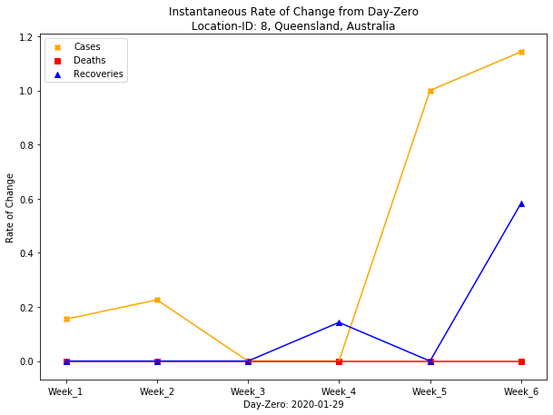
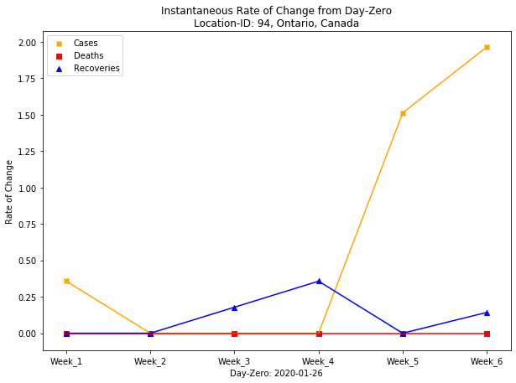
What Now?

Slide 9
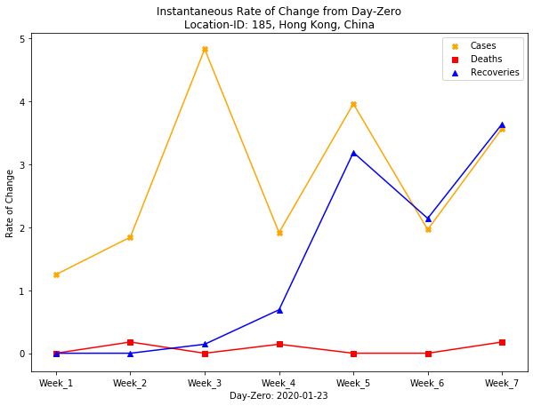
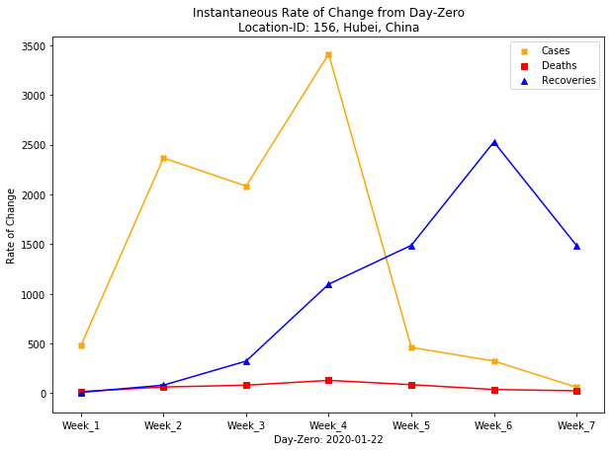
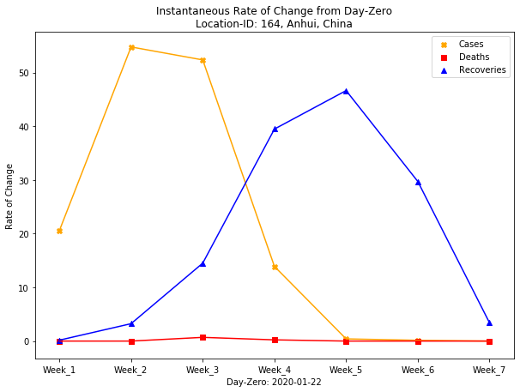
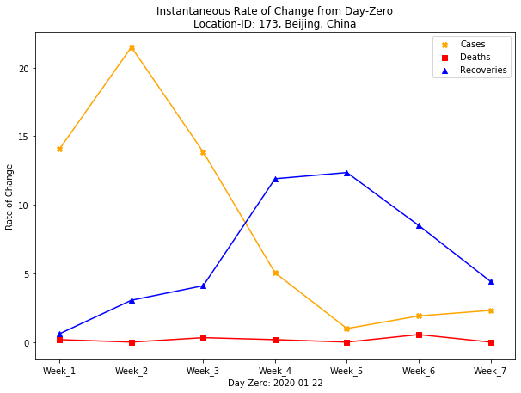
Notes:
Reactive measures

Slide 10
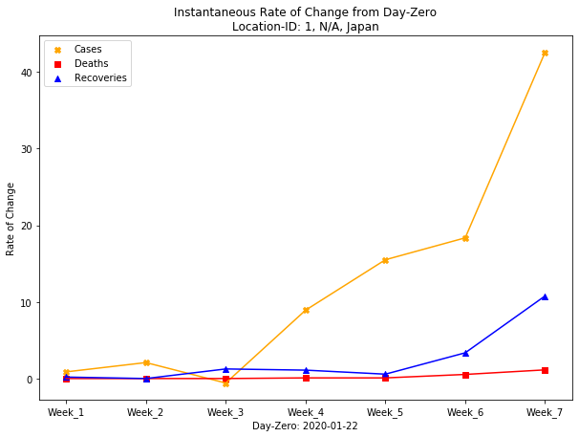
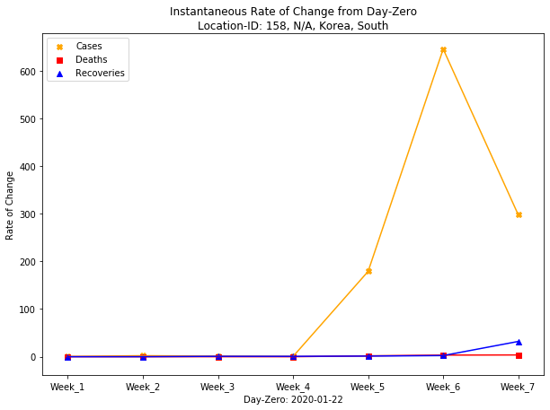
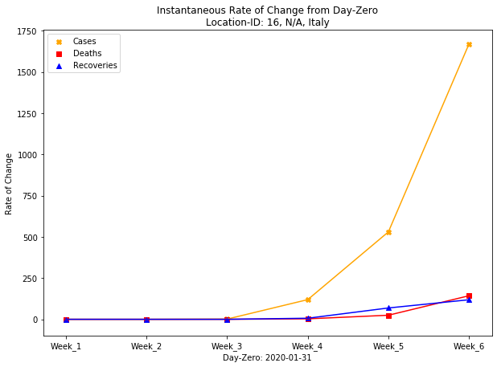
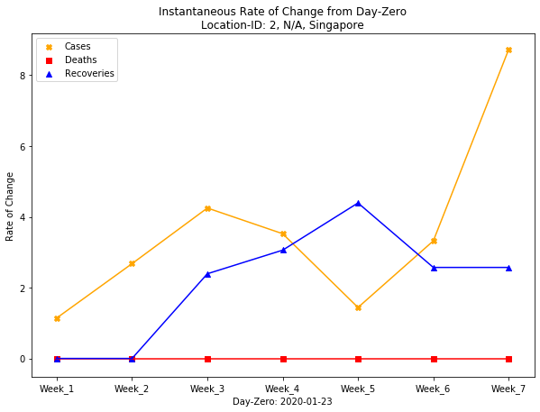
Notes:
Singapore proactive measure
South Korea proactive measure

Slide 11

Let’s revisit our Hypothesis
$H_{0}: {\tilde{x}}_{CaseRateLo} −{\tilde{x}}_{CaseRateHi}=0$
How should we define High and Low Case Rates?
What variable best describes the curve pattern?
What is the expectation?

Slide 12
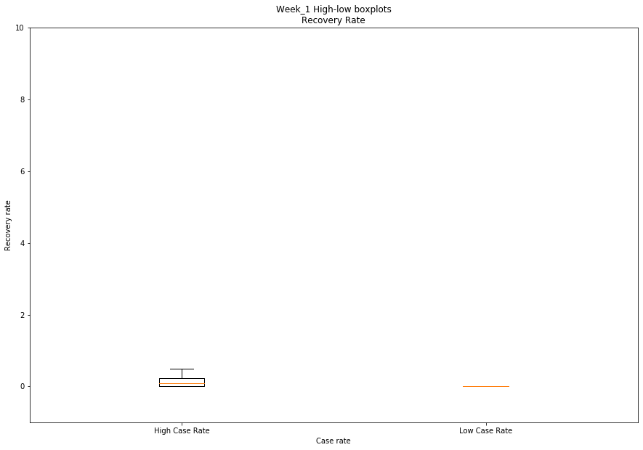
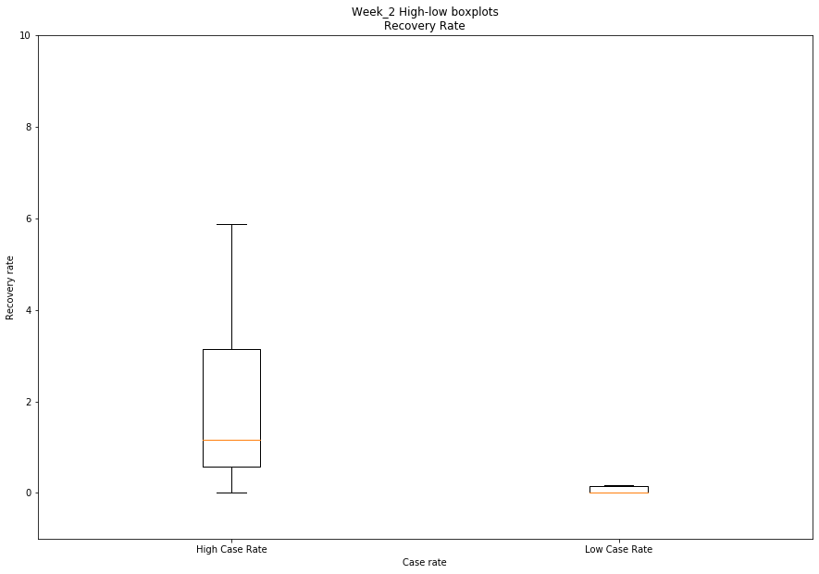
Visual check
Notes:
BOXPLOT/VIOLINPLOT

Slide 13
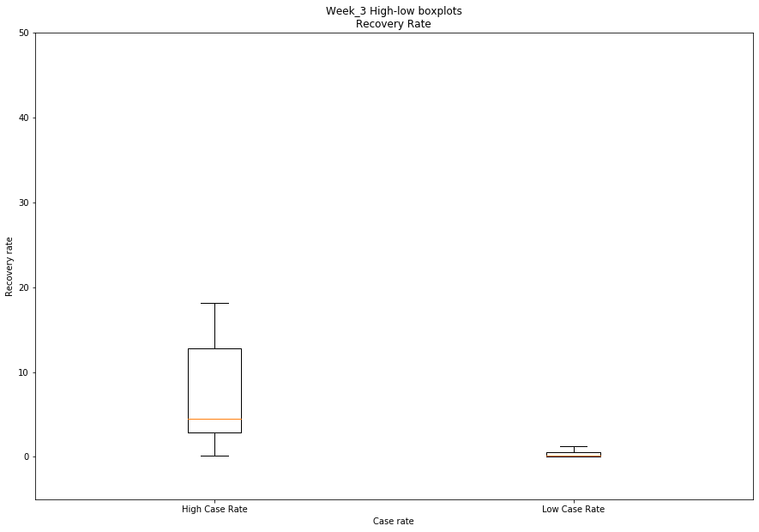
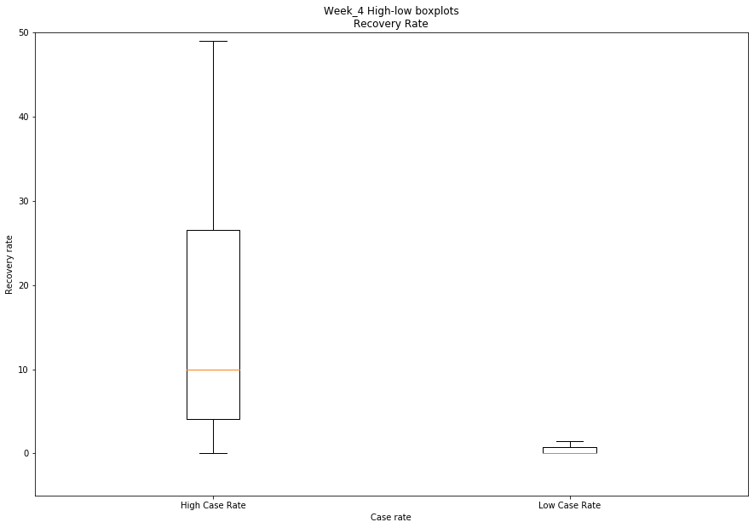
Visual check

Slide 14
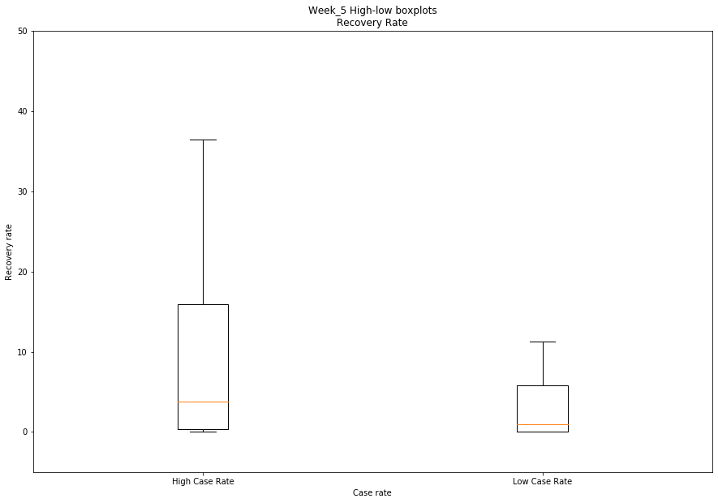
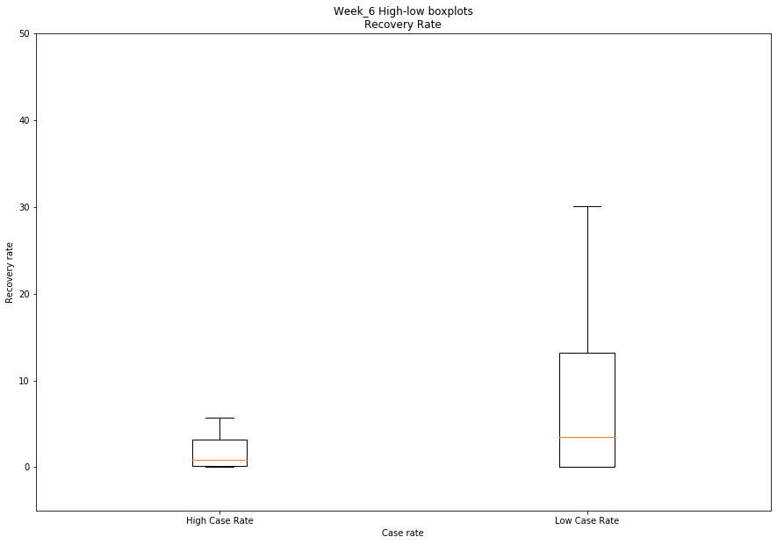
Visual check

Slide 15
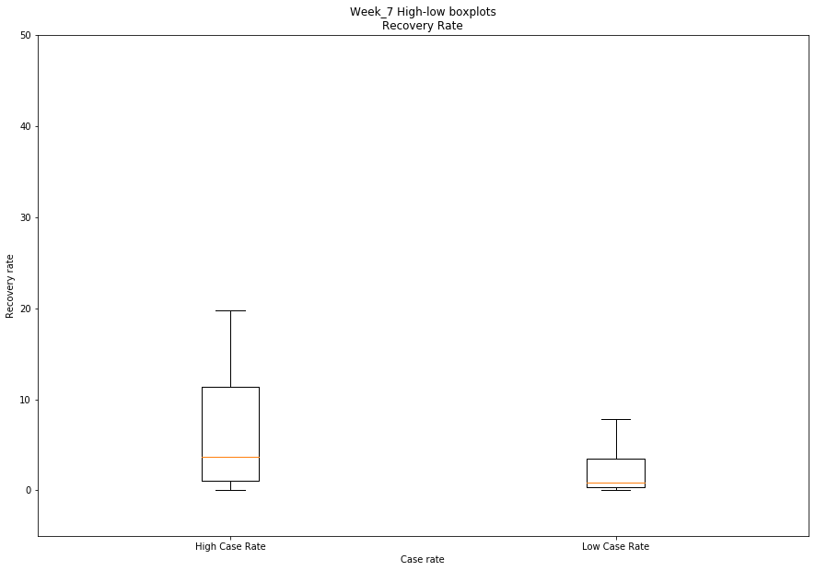
Visual check

Slide 16
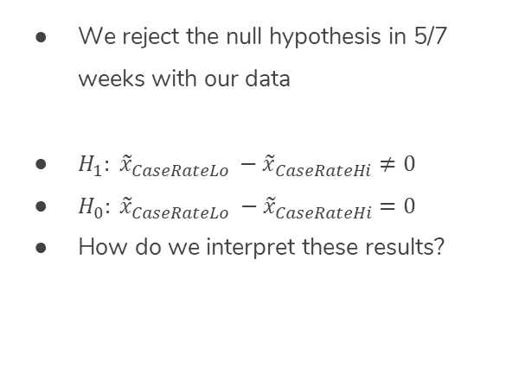
Kruskal-Wallis Test
Week | K_values | p_values | psig
Week_1 | 15.989537 | 6.369351e-05 | True
Week_2 | 36.171767 | 1.806692e-09 | True
Week_3 | 38.741619 | 4.837830e-10 | True
Week_4 | 34.442874 | 4.389469e-09 | True
Week_5 | 3.103047 | 7.814590e-02 | False
Week_6 | 0.698105 | 4.034212e-01 | False
Week_7 | 4.545701 | 3.300151e-02 | True
We reject the null hypothesis in 5/7 weeks with our data
$H_{1}: {\tilde{x}}_{CaseRateLo} −{\tilde{x}}_{CaseRateHi}≠0$
$H_{0}: {\tilde{x}}_{CaseRateLo} −{\tilde{x}}_{CaseRateHi}=0$
How do we interpret these results?

Slide 17
Conclusion

Slide 18
Conclusion
High variability in recovery rate within the first four weeks of the disease entering a location
At approximately the 5-week mark, we see the medians converge
Week-7 may be anomalous, but it still has a p-value of 0.03
Smallest sample size of all Week-Data
Will continue to see how the median recovery rates trend in future weeks

Slide 19
Summary
Lack of correlation
Further exploration
Patient demographics
Population analysis
Air quality
Comparison to Previous Pandemics
SARS
MERS

Slide 20
Questions?

